Slide 1
Capstone Project: M.L. Fundamentals
Question: Are psychosocial variables predictive of, or associated with, relationship ‘Status’ (i.e. single, etc)?
BY: ALBERT Wallace Deckel
1/14/2019
Awdeckel@gmail.com

Slide 2
TABLE OF CONTENTS
Question to be answered
Exploration of dataset
Augmentation of dataset
Classification Approaches (and Discussion)
Regression Approaches (and Discussion)
Summary/Next Steps

Slide 3
Question to be answered:
Can relationship status (i.e., married, single, divorced, etc) be predicted by and/or are they associated with the following psychosocial variables??
1. Drug Use
2. Drinking History
3. Smoking History
4. Body Type
5. Age
6. Gender
7. Writing Ability (i.e., Essay Length)

Slide 4
Exploration of Data Set:
Once missing values were dropped, a total of 39427 subjects were included in this project. The breakdown of the composition of the features of these subjects is shown on the next slide.

Slide 5
E
Exploration of Data Set:
Variables
Drink History | Socially: 41780 | Rarely: 5957 | Often: 5164 | Never: 3267 | Very Often: 471 | Desperate: 322
Drug Use | Never: 37724 | Sometimes: 7732 | Often: 410
Smoking | No: 43896 | Sometimes: 3787 | When drinking: 3040 | Yes: 2231 | Trying to quit: 1480
Body Type | Fit: 12711 | Athletic: 11819 | Thin: 4711 | Curvy: 3924 | A little extra: 2629 | Skinny: 1777 | Full fig: 1009 | Overwt: 444 | Jacked 421
Age | 26-69
Gender | Male: 35829 | Female: 24117
Writing Ability | Length: Min: 784 | Length: Max: 96277

Slide 6
Exploration of data:
The graph on the next slide is a pairwise plot of all of the variables used in these computations. The legends are a little hard to read, but it can be seen by examination of the graphs that there are none that show a linear distribution to the variable of interest, relationship status.
The fourth row down on the graph represents the pairplots between status and the the 7 predictor variables.

Slide 7
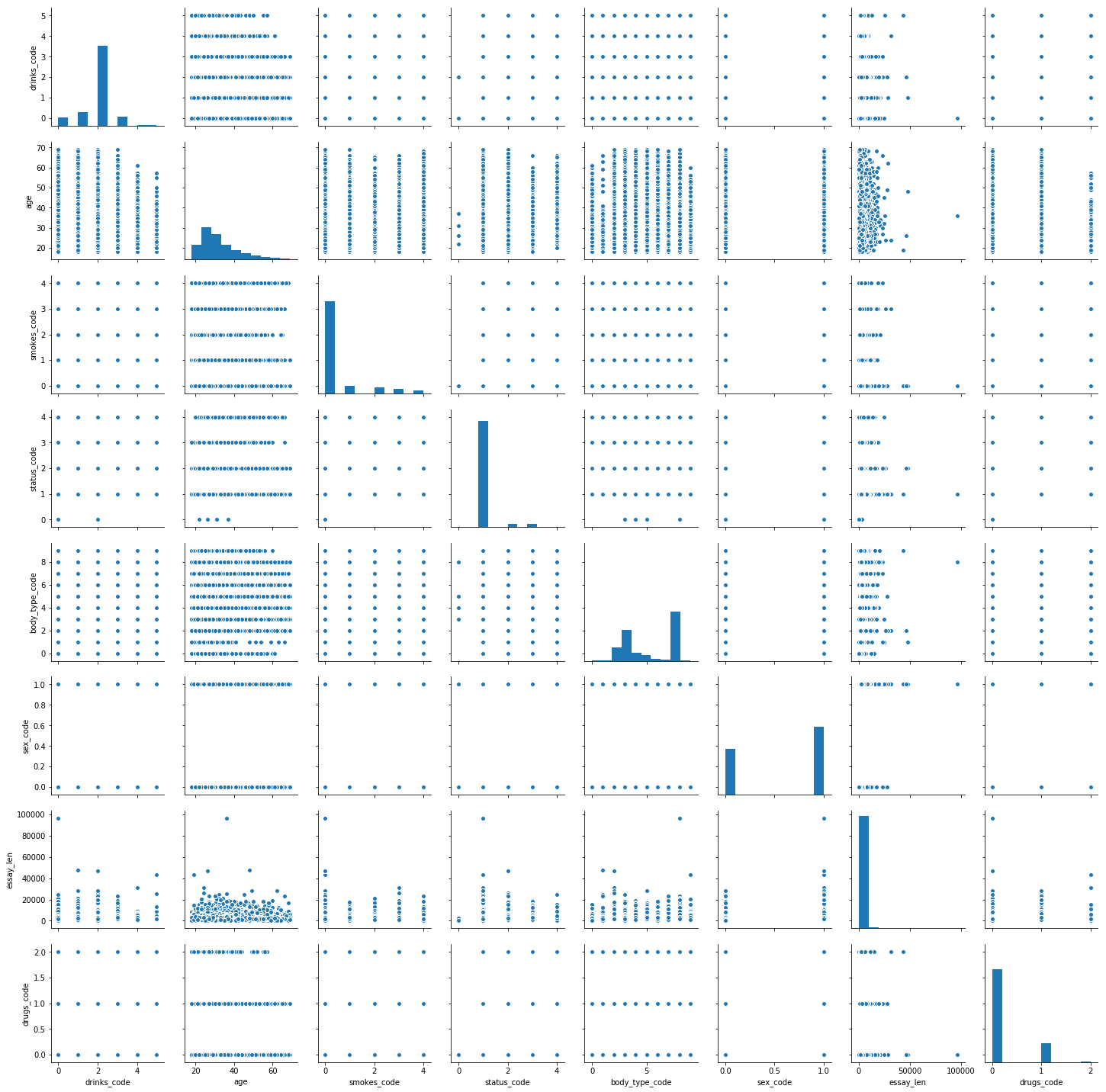
Exploration of data set (cont)

Slide 8
Exploration of data:
The next graph shows the distribution of relationship status. As can be seen in the graph, the data is heavily skewed to the “single” column. This violates the principal of ‘random distribution’ for the regression analyses.
The second slide shows the distribution of data for the two continuous variables, age and essay length.

Slide 9
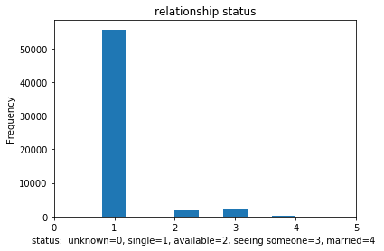
Relationship Status
rRelationship Status
frfrequency
single
available
Seeing someone
married

Slide 10
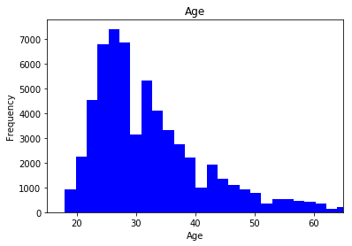
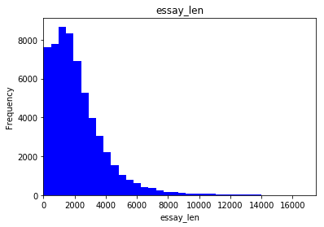
Distribution of Age and Essay Length Variables:
Age
Essay Length
ffrequency
ffrequency

Slide 11
Augmentation of data set
A total of 8 variables, including ‘status’, had their data changed from string to numerical values. All were then combined into a DataFrame feature_array. Additionally, a new column including only ‘status’ was created and added to the array. The other newly created variables were on:
1. Drug Use
2. Drinking History
3. Smoking History
4. Body Type
5. Age
6. Gender
7. Writing Ability (i.e., Essay Length)

Slide 12
Classification Algorithms:
Total time to run algorithm 0.8155758380889893
0.8155
First Algorithm Used:
K-Nearest Neighbors

Slide 13
Classification Approaches: k-Nearest Neighbors Results
accuracy 0.9316932961366134
recall 0.9316932961366134
precision 0.8817261503545546
f1 0.9037144984661977
Time to run the algorithm 0.3812704086303711
accuracy 0.9401470961197058
recall 0.9401470961197058
precision 0.9305115069316553
f1 0.9157193349774686
Total time to run algorithm 0.6784818172454834
train data
test data

Slide 14
Classification Approaches: k-Nearest Neighbors Results
avg / total 0.93 0.94 0.92 11829
precision recall f1-score support
0 0.00 0.00 0.00 1
1 0.94 1.00 0.96 11066
2 0.12 0.02 0.03 332
3 0.08 0.00 0.01 363
4 0.00 0.00 0.00 67
avg / total 0.88 0.93 0.90 11829
Train Data
precision recall f1-score support
0 1.00 1.00 1.00 1
1 0.94 1.00 0.97 11066
2 0.59 0.08 0.14 332
3 0.89 0.07 0.13 363
4 1.00 0.03 0.06 67
Test Data
avg / total 0.93 0.94 0.92 11829

Slide 15
Classification Approaches: k-Nearest Neighbors Results
TEST confusion_matrix
array([[ 1, 0, 0, 0, 0],
[ 0, 11066, 0, 0, 0],
[ 0, 305, 27, 0, 0],
[ 0, 321, 17, 25, 0],
[ 0, 60, 2, 3, 2]]

Slide 16
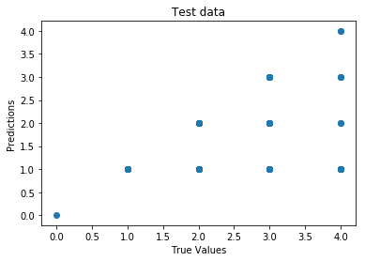
Classification Approaches: k-Nearest Neighbors: Graphic Results
Test Data
PPredictions
True Values

Slide 17
Discussion
k-Nearest Neighbors
This analysis is flawed due to the skewing of the raw data of the relationship ‘status’ to a value of ‘1’ (i.e., single), and to the resulting overfitting. The confusion matrix makes this clear, with many of “true” classifications of the other status data (i.e.,. married, in a relationship, etc) being assigned to the single category by the data.

Slide 18
Classification Algorithms:
Second Algorithm Used:
K-Means

Slide 19
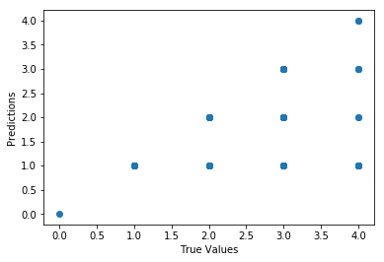
Classification Approaches: K-Means Results
TRAIN Analysis of Data
accuracy 0.9401470961197058
recall 0.9401470961197058
precision 0.9305115069316553
f1 0.9157193349774686
total time to run program 0.4503
K-Means Classification of Status
Performance
True Values

Slide 20
Classification Approaches: K-Means Results classification report
precision recall f1-score support
0 1.00 1.00 1.00 1
1 0.94 1.00 0.97 11066
2 0.59 0.08 0.14 332
3 0.89 0.07 0.13 363
4 1.00 0.03 0.06 67
avg / total 0.93 0.94 0.92 11829
accuracy 0.9401470961197058
recall 0.9401470961197058
precision 0.9305115069316553
f1 0.9157193349774686

Slide 21
Classification Approaches: K-Means Confusion Matrix
array([[ 1, 0, 0, 0, 0],
[ 0, 11066, 0, 0, 0],
[ 0, 305, 27, 0, 0],
[ 0, 321, 17, 25, 0],
[ 0, 60, 2, 3, 2]]

Slide 22
Discussion K-Means
Discussion:
Like K-Nearest Neighbors, K-Means basically assigned all of the outcome predictions to the “single” category. The f1 score from the classification report shows that the categories outside of “single” (i.e., unknown, married, in a relationship, etc) were very poorly classified. The confusion matrix confirms this.

Slide 23
Multiple Regression

Slide 24
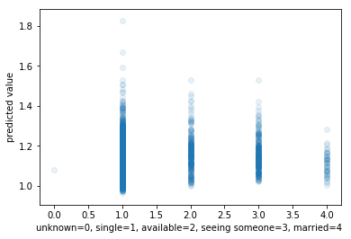
coefficient_of_determination: R2 =: 0.025118751679393148
Regression Algorithm: Multiple Regression
score,(X_test, y_test) 0.02511
coefficient values [-1.07569869e-02 -1.28180340e-03 -4.36362064e-03 -7.61180999e-03
-7.83641759e-03 2.57462624e-05 8.68577070e-02]
time to run the program 0.2563
coefficient_of_determination:
R2 = 0.0258

Slide 25
Regression Algorithm: Multiple Regression
Discussion
Multiple regression did an extremely POOR job of predicting the score of the predicted variable, ‘status’. The R-squared of R2 = .0251 indicates that the analysis only accounted for 2+% of the variance in the data. The graphs visually demonstrate the poor predictive power of the algorithm.
This analysis is also plagued by the use of non-normally distributed, categorical variables, typically described as inappropriate data for this analysis.

Slide 26
Regression Algorithm:
KNeighborsRegressor

Slide 27

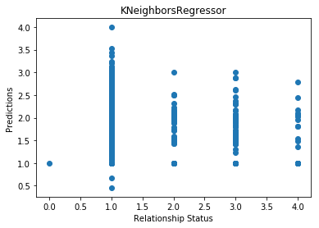
KNeighbors Regressor
time to run the program
0.5884
R2 =: -0.420
Predictions
Relationship ‘Status’

Slide 28
Discussion
Like Multiple Regression and the classification algorithms, KNeighborsRegressor was unable to predict the scores on the ‘status’ variable from the various predictors used in my feature_data file.
As before, skewed data in the ‘status’ variable, a response by the large majority of participants that they are single, lack of a random distribution of the variables invalidated the analyses.

Slide 29
Summary of Findings
The ‘status’ variable (i.e., single, married, in a relationship, etc) was highly skewed to the ‘single’ category and in retrospect was a poor choice for this analysis. The use of classification variables as predictors was also a poor choice for regression analyses, as the data was not normally distributed.
Neither the Classification nor Regression algorithms were able to accurately predict , or prove an association between, the ‘status’ variable and the psychosocial variables used.
From a timing perspective, the Multiple Regression algorithm ran the fastest, with the others running at least 30+ milliseconds longer that Multiple Regression.
I found the Multiple Regression to be the easiest algo to run. It also ran the fastest of any of the algos. However, for predicting stock market values, the KNeighborsRegressor method of assigning scores to unknown variable sounds of particular interest. Of the two classifications, K-Means was the simplest and easiest of the algos for me to run.

Slide 30
Answer to the question posed in this study
Question: Are psychosocial variables predictive of, or associated with, relationship ‘Status’ (i.e. single, etc)?
Answer: The answer remains unknown as all of the algos had very poor metrics (i.e., f1, precision, etc) in their use with this data.

Slide 31
Next Steps
Recruitment of more subjects would increase the number of subjects in the categories other than being single.
Since the data is not normally distributed, non-parametric approach to analyzing the data may prove to be more useful.
3. Adding other items onto the ‘status’ variable on the questionnaire’ might lead to better parsing and understanding the ‘status’ data. For example, the question of “how many dates have you ever gone on”, “how long since your last data”, “are you more interested in finding, through your dating, ‘Mr./Ms. Right’ , or for a friend, or for sexual partners “, etc, would likely be more amenable to better understanding aspects of their ‘status’.

